Slide 1
DairyDome
Name : Prasad Ravindra Patil
Class : MCA II (Technocats)
Roll : 32
Project Guide : Mrs. Swati Kirange
Company Name : Dudh Utpadak Sahkari Sanstha Maryadit Advihir [R.N :- 297]

Slide 2
Existing System
An existing system provides manual paperwork or an excel sheet to track the buying and selling product details.
The customer has to go to the medical shop where the customer can get the required dairy products. Most of the time customer does not get required product which him/her looking the products at different locations. Which results in wasting a lot time in it.
In the existing system, you cannot provide feedback of the service provided to the admin (shopkeeper) directly.

Slide 3
Need of System
The new system is totally Web based application. Nowadays, there is dairy shop management which benefits customers greatly.
A new system provides features like time efficiency to show product details and whatever the customer will give the feedback to the admin(shopkeeper).
This system provides various types of dairy products.
The buying of product is done easily by customer.

Slide 4
Operating Environment-Hardware and Software
Hardware :
Software :
Processor | i5
Hard Disk | 28 GB or More
RAM | 4 GB or More
Operating System | Windows or Any
IDE | VS Code
Python Version | 3.9.13
Django Version | 3.2
Operating System | Any
DataBase | SQlite
Browser | Any

Slide 5
Proposed System
System need to maintain quantity record.
System need to keep the record of Student.
System need to update and delete the record.
System also needs a search area.
It also needs a security system to prevent data.

Slide 6
Objectives:
To manage and maintain data more easily through this web application.
To ensure the system is user-friendly to satisfy the users' needs.
To provide results very quickly.
To allow users to securely store and organize their diary entries.
To enable easy retrieval and editing of past entries.
To offer customizable templates for diary entries to suit different users.
To support multimedia attachments such as photos and audio recordings within entries.
To ensure data privacy and protection with robust security features.
To integrate with calendars and reminders for better diary management.
To provide a search function to quickly find specific entries or topics.
To offer synchronization across multiple devices for convenient access.
To include options for exporting and sharing diary entries.

Slide 7
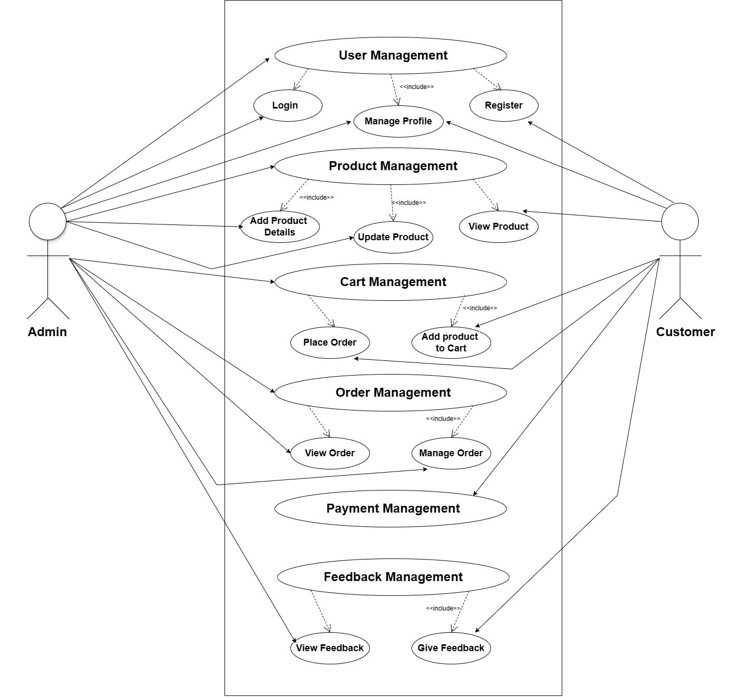
Use Case Diagram
Use case Diagram

Slide 8
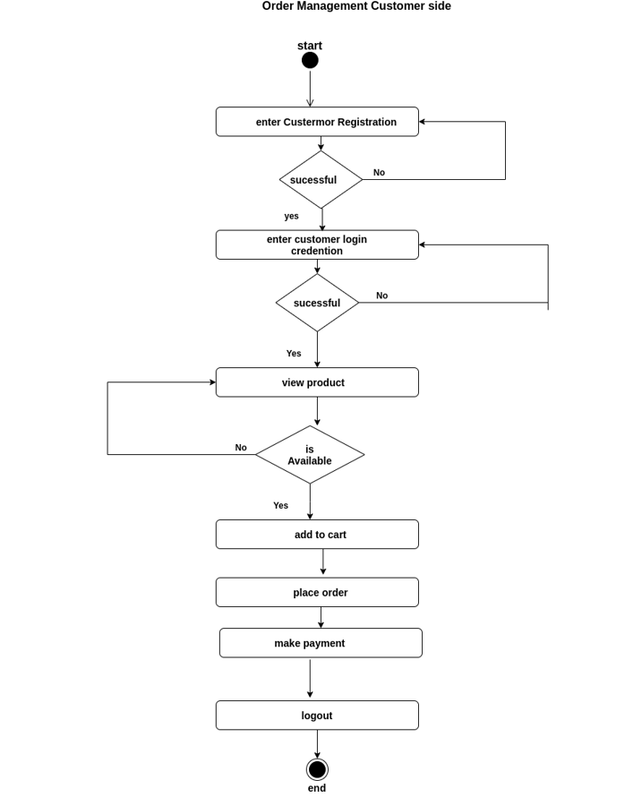
Activity Diagram
Activity Diagram

Slide 9
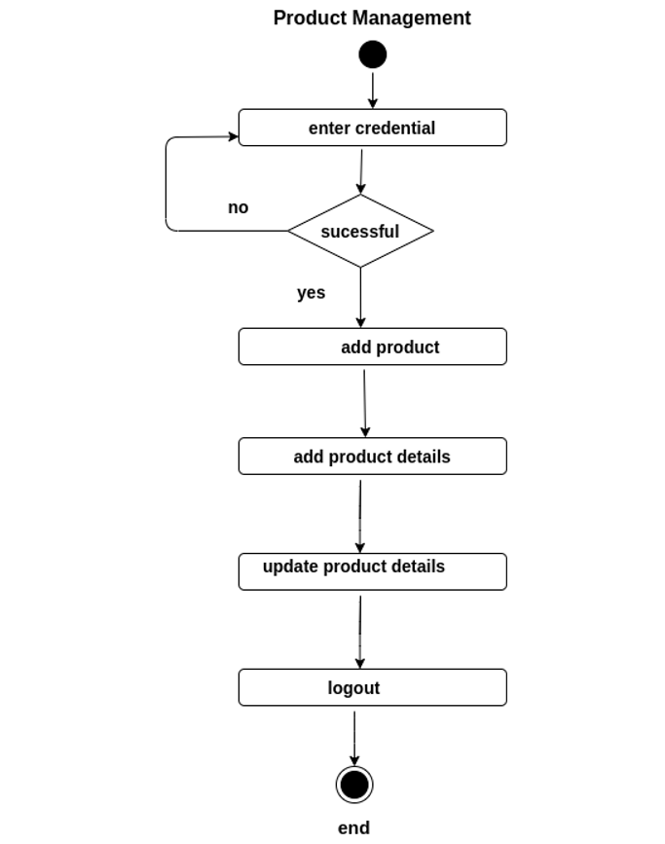
Activity Diagram

Slide 10
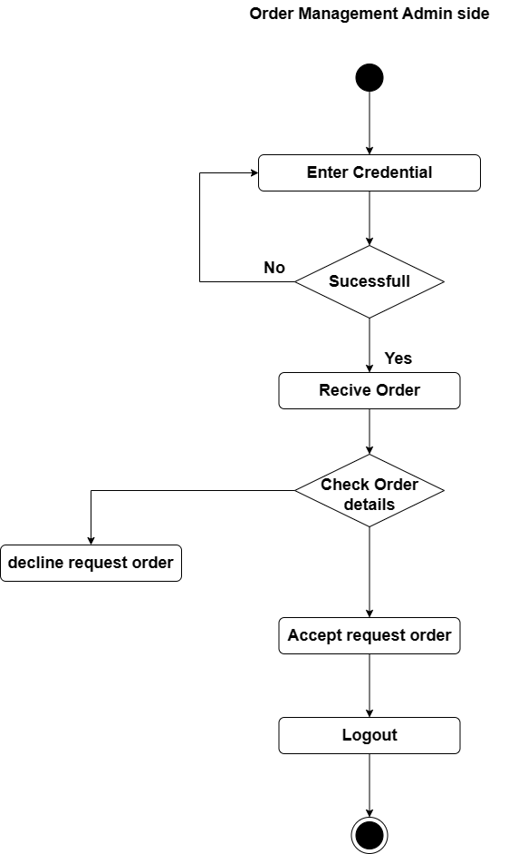
Activity Diagram

Slide 11
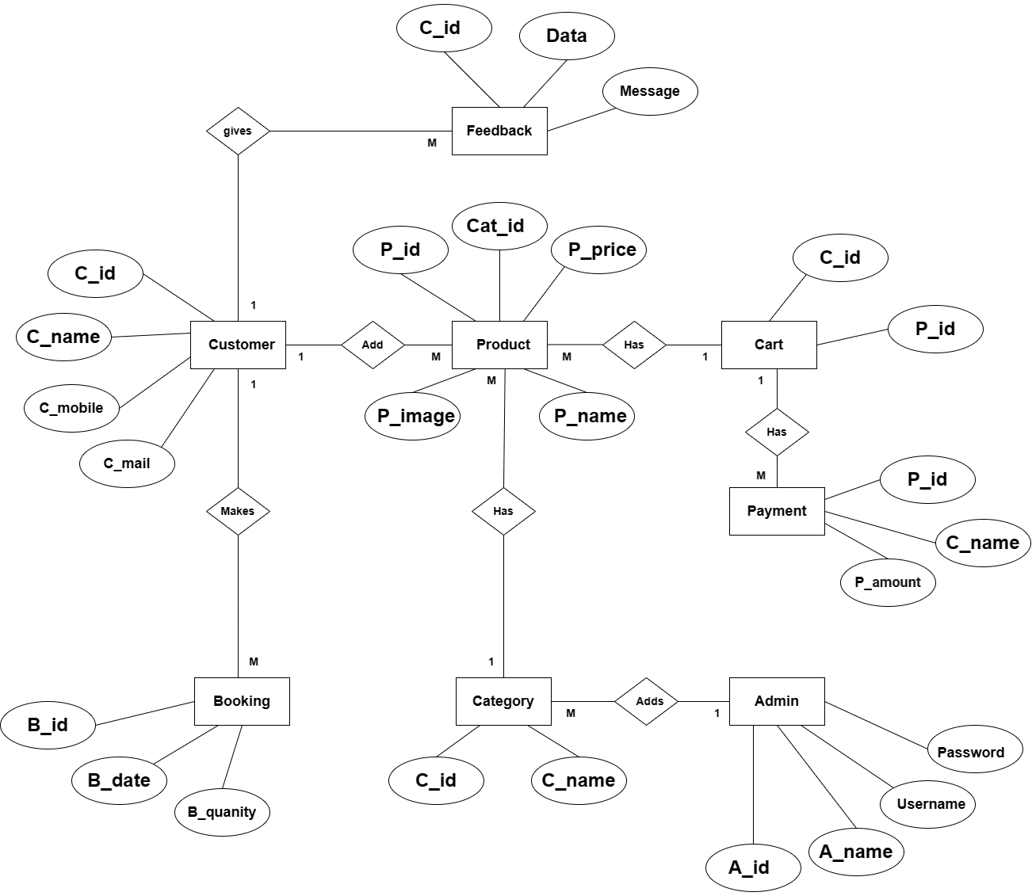
Entity Relationship Diagram

Slide 12
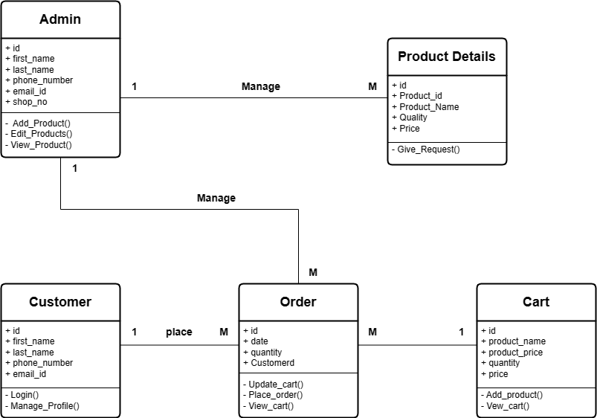
Class Diagram
Class Diagram

Slide 13
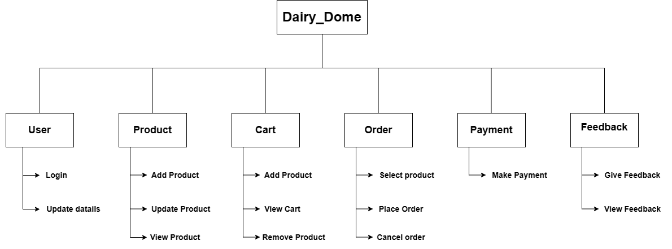
functional decomposition diagram

Slide 14
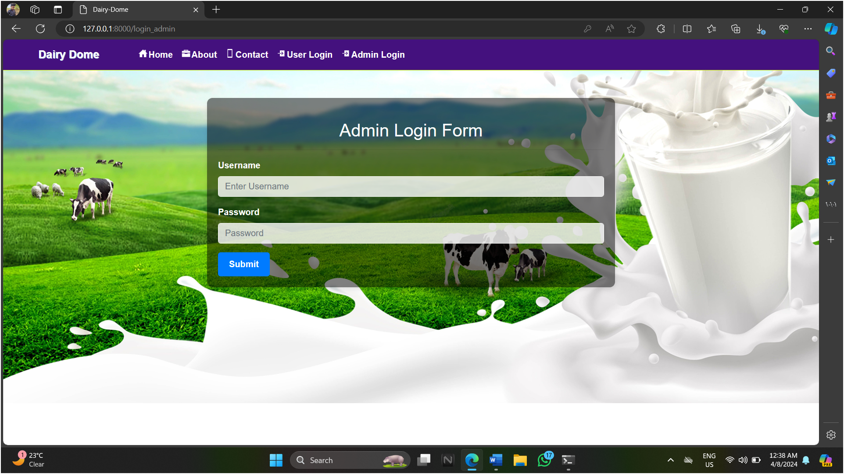
User Interface Screen

Slide 15
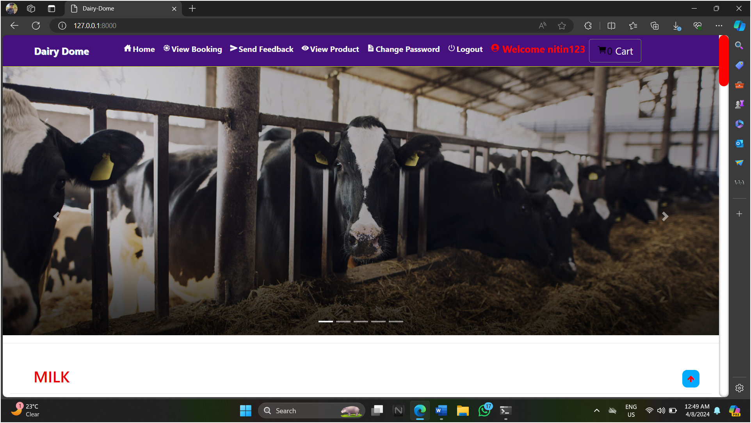
Home Page

Slide 16
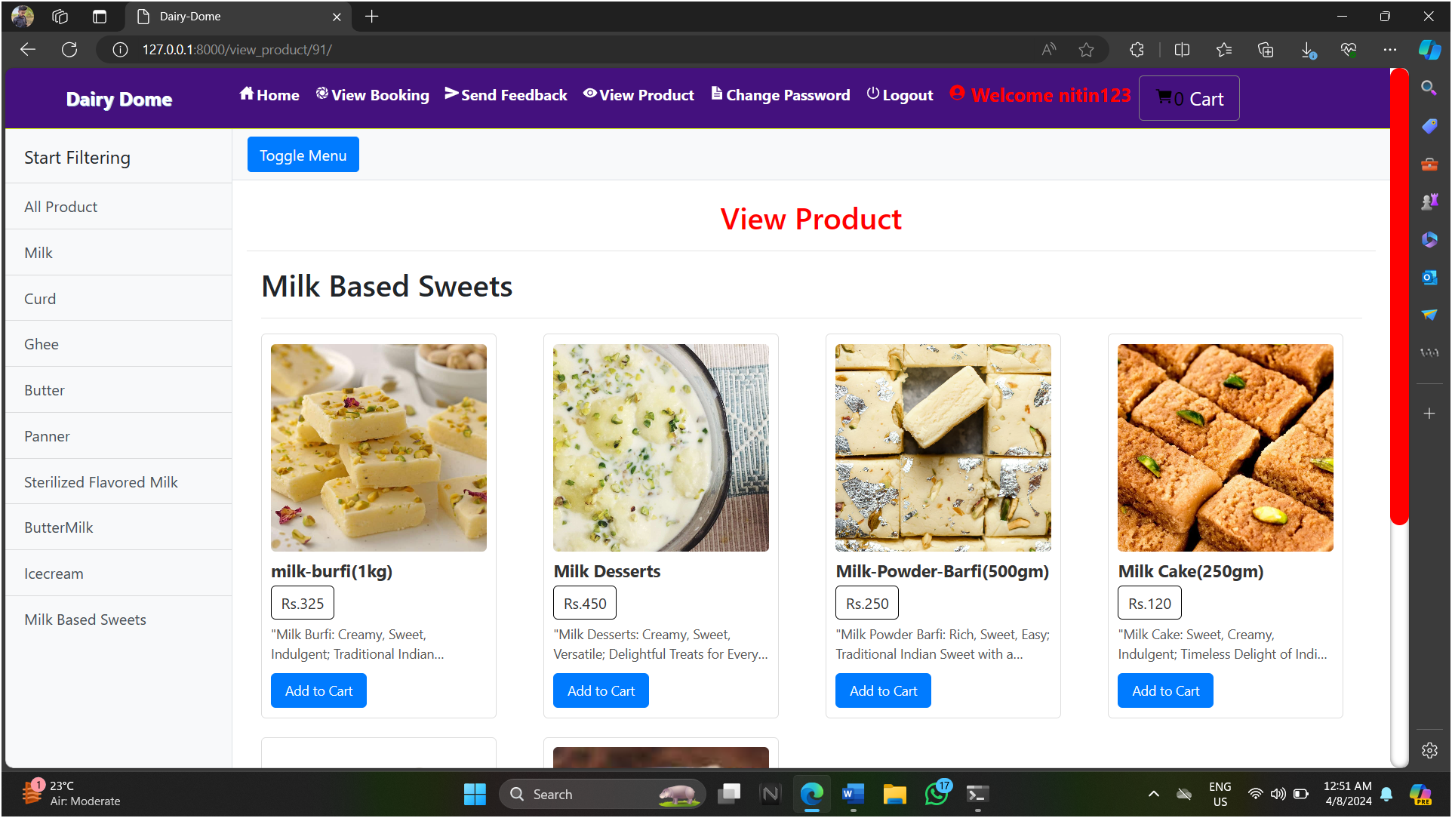
View Product:-

Slide 17
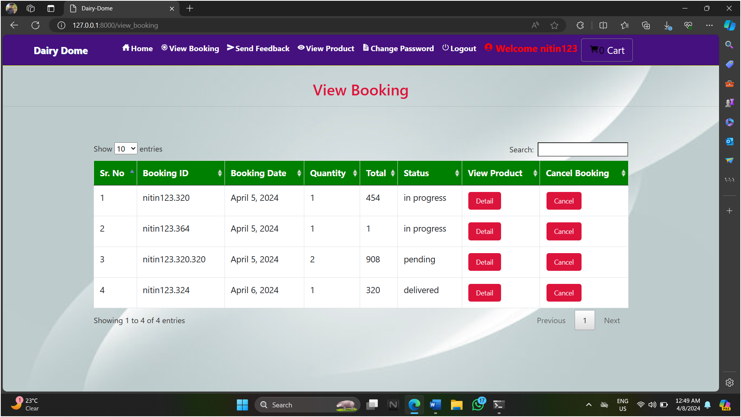
View Booking:-

Slide 18
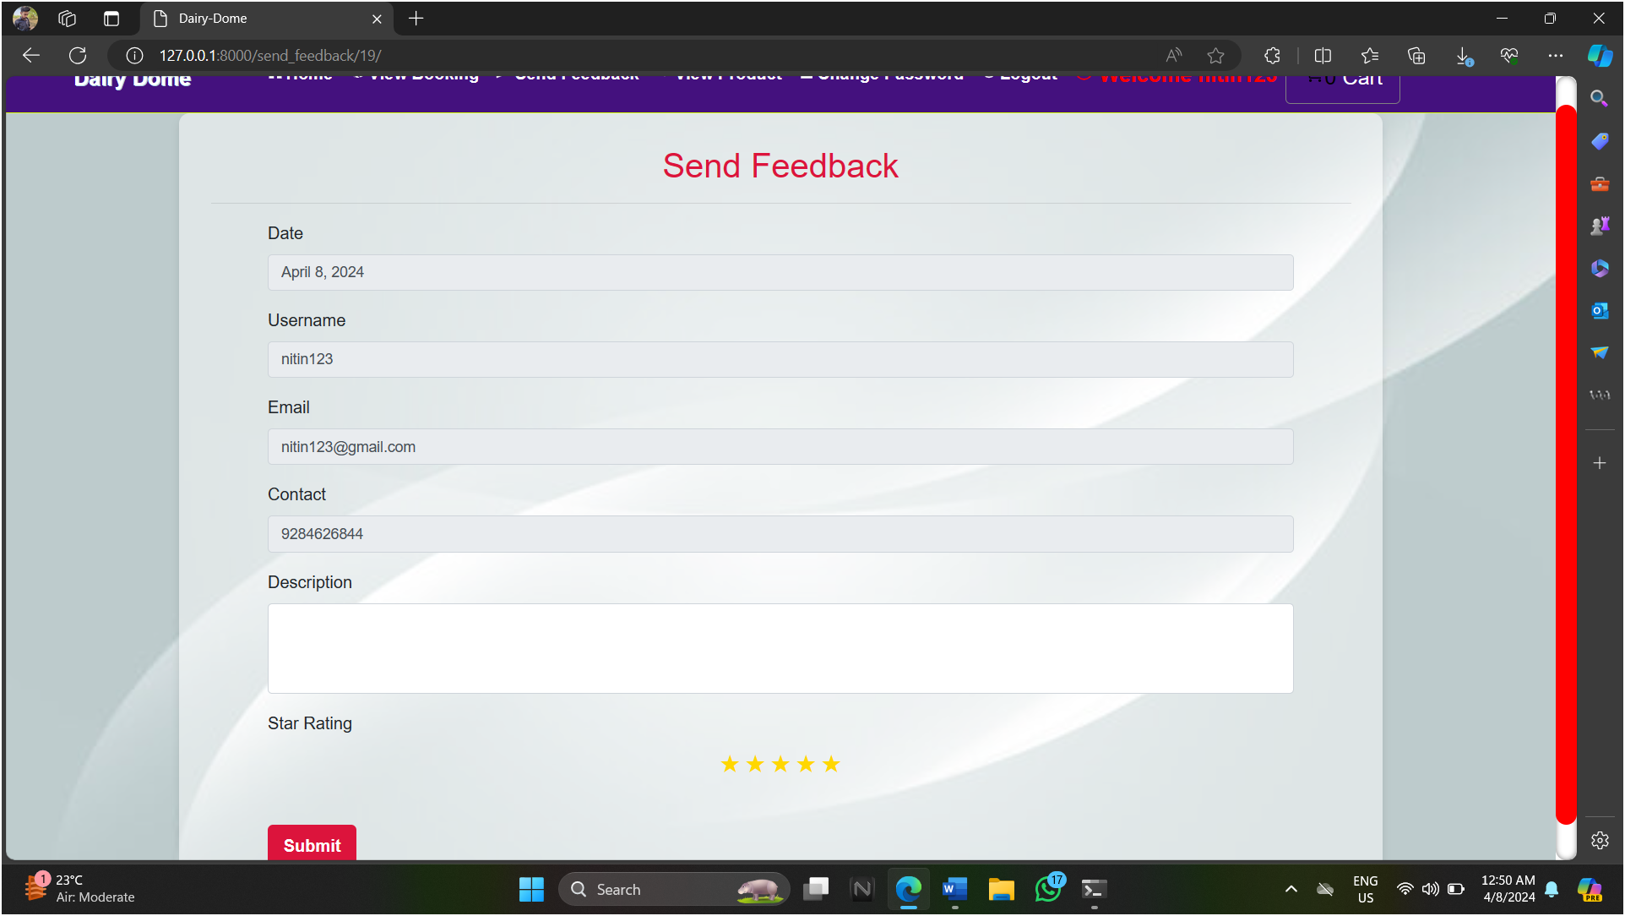
Send Feedback:-

Slide 19
Profile
Sr no | Name | Data Type | Constraints
1. | Id | Integer | Not Null, Primary Key
2 | Dob | Date | Not Null
3 | City | Varchar | Not Null
4 | Address | Varchar | Not Null
5 | Contact | Varchar | Not Null
6 | Image | Varchar | Not Null

Slide 20
Product
Sr no | Name | Data Type | Constraints
1 | Image | Varchar | Not Null
2 | Name | Varchar | Not Null
3 | Price | Integer | Not Null
4 | Desc | Varchar | Not Null
5 | Category_id | Integer | Not Null

Slide 21
CART & CATEGORY
Cart
CART
Sr no | Name | Data Type | Constraints
1. | Id | Integer | Not Null, Primary Key
2 | Product_id | Integer | Not Null
3 | Profile_id | Integer | Not Null
CATEGORY
Sr no | Name | Data Type | Constraints
1. | Id | Integer | Not Null, Primary Key
2 | Name | Varchar | Not Null

Slide 22
Booking
SR No Table Structure
Sr no | Name | Data Type | Constraints
1 | Book_date | Varchar | Not Null
2 | Total | Integer | Not Null
3 | Booking_id | Varchar | Not Null
4 | Profile_id | Integer | Not Null
5 | quantity | Varchar | Not Null

Slide 23
Test Case
Test Case Name: Registration
Test Case ID: TC01_Registration
Test Case Prerequisite: User must launch Campus training and placement portal.
Sr. No | Test to be Performed | Expected Result | Actual Result | Test Pass/Failed | Remark
1. | Do the registration with empty fields. | Registration failed. Message should be display “Please fill the all details”. | Registration failed. Message shown “Please fill the all details”. | Pass
2. | Do the registration with duplicate username. | Registration failed. Message should be display “Username already registered”. | Registration failed. Message shown “Username already registered”. | Pass
3. | Do the registration with invalid email address. | Registration failed. Message should be display “Invalid email id”. | Registration failed. Message shown “Invalid email id”. | Pass
4. | Enter valid mobile number. | Registration should be successful. | Registration Successful. | Pass
5. | Do the registration with full name containing at least first name and last name without space. | Registration failed. Message should be display “Full name contains at least first name & last name with space”. | Registration failed. Message shown “Full name contains at least first name & last name with space”. | Pass
6. | Verify whether the user has leave empty field. | Registration should be Failed. All fields are mandatory. | Registration Failed. | Pass

Slide 24
Test Case
Test Case Name: Login
Test CaseID: TC02_Log_in
Test Case Prerequisite: User must launch the campus training and placement portal.
User must be registered.
Sr. No | Test to be Performed | Expected Result | Actual Result | Test Pass/Failed | Remark
1. | Check login with valid data | Login successful &should be open home Page | Login successful. Home page opened. | Pass
2. | Check login with invalid data | Login failed. Message should be display “Username or Password is invalid”. | Login failed. Message shown, “Username or Password is invalid”. | Pass
3. | Check login with empty fields. | Login failed. Message should be display “Please fill all the fields”. | Login failed Message shown “Please fill all the fields”. | Pass
4. | Check whether username or password is case sensitive | Login failed, Message should be displayed “Username or Password is invalid”. | Login failed message shown “Username or Password is invalid”. | Pass

Slide 25
Test Case Name: Tpo Test Case ID: TC03_Tpo Test Case Prerequisite: User must be Login . User must launch the campus training and placement portal
Sr. No | Test to be Performed | Expected Result | Actual Result | Test Pass/Failed | Remark
1. | Store Xml File | Error should come. | Xml file store. | Pass
2. | Parse the xml file for conversion . | Accepted | File get Prase | Pass
3. | Attribute Identification | Accepted | Identify Attribute | Pass
4. | Weight analysis | Accepted | Analyse weight of actual attribute | Pass

Slide 26
Test Case Name: Test Case ID: TC04_ Test Case Prerequisite: User must launch the campus training and placement portal User must be Login.
Sr. No | Test to be Performed | Expected Result | Actual Result | Test Pass/Failed | Remark
1. | Tree Formation | Accepted | Formation | Pass
2. | Cluster Evaluation | Accepted | Should check cluster. | Pass
3. | Algorithm | Accepted | Should work algorithm properly. | Pass
4. | Query Formation | Accepted | Should check Query | Pass

Slide 27
Drawback and Limitations
The purpose of this project is to provide Dairy products to directly the consumers more effectively than the existing system.
The limitation with the application can also be looked into and enhancement can be made as per user requirement.

Slide 28
Proposed Enhancement
In future there is a chance change the application according to the requirements.
In future we can add Chatbot for clarifying our doubts.
User will get the receipt of the payment.
Will also add maps to locate stores for nearby areas .

Slide 29
CONCLUSION
The system will be able to serve as web application when it is finally developed, where these small upcoming shops can make use of it to publish different categories of Dairy products in a wide range and also help the shop to manage their service more effectively. On the other hand, it will enable customers to freely buy their required type of product more freely and interactively.

Slide 30
Thank You

